Slide 1
Cryptocurrency Arbitrage
Sam Abbate

Slide 2

Arbitrage in Review
The simultaneous purchase and sale of an asset in order to profit from a difference in the price.
Market price
“Asset”

Slide 3

The Mission
This project has two goals:
To discover if arbitrage opportunities exist within cryptocurrency markets
To develop a tool to that
analyzes market values
and recommends to the
user the best places to
but and sell BTC for profit.

Slide 4


Arbitrage Opportunity
Professional trading websites
Site listings by individuals
Willing to buy BTC above the market price because
1). Paying with some commodity other than USD
2). Haven't adjusted asking price to match volatile market price.

Slide 5

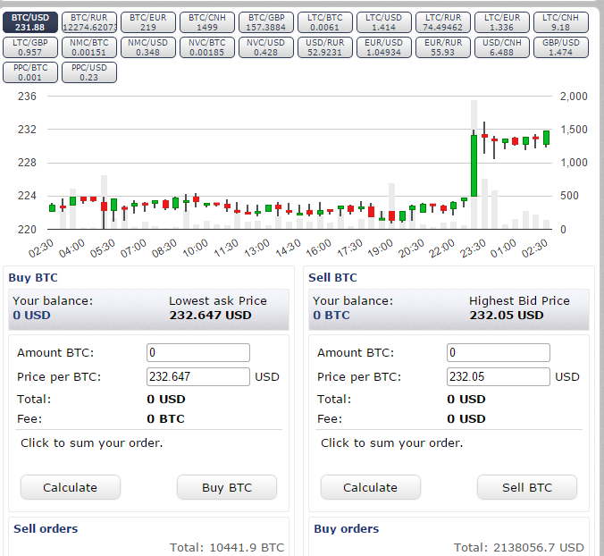
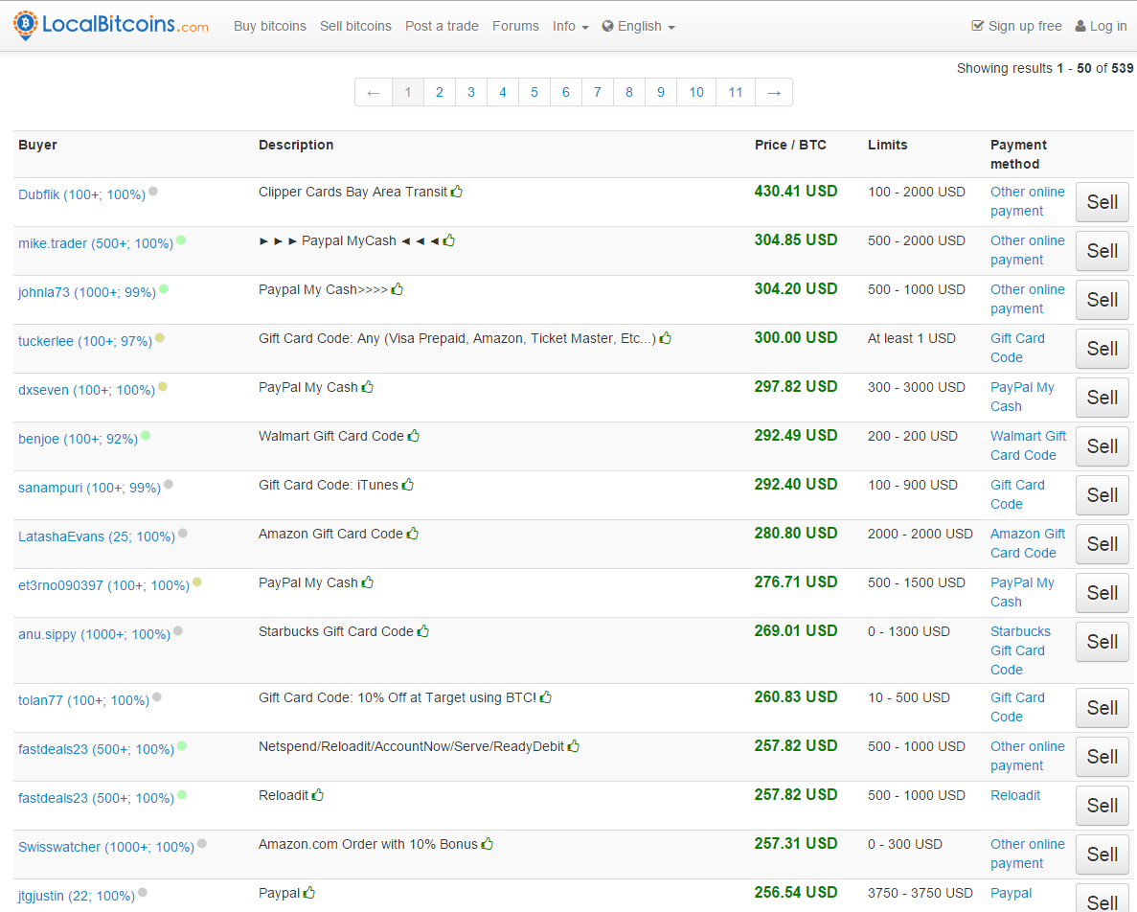
Developed Tool
Use this tool and become the Hans Gruber of BTC trading

Slide 6
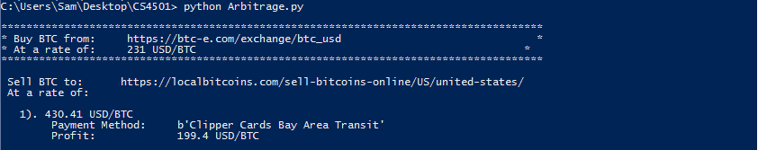
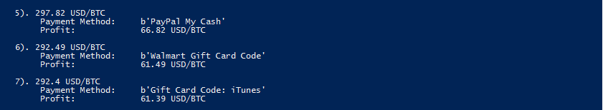
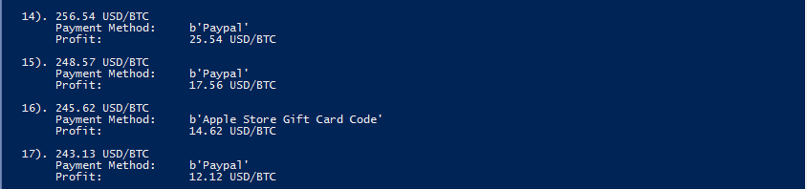
Results

Slide 7
Data Sites
1. https://btc-e.com/exchange/ltc_usd
Provides information on current market price of Bitcoin
2.https://localbitcoins.com/buy_bitcoins
Listings of people selling bitcoin for various payment methods
3. https://localbitcoins.com/sell-bitcoins-online/US/united-states/
Listings of people buying bitcoin for various payment methdos
4. https://shapeshift.io/#
Tool for coverting cryptocurrencies
5. https://cex.io/sell-bitcoins
Another exchange service for BTC/LTC

